Slide 1
Predictive Maintenance In
Machine Tools

Slide 2
INTRODUCTION
In today's rapidly evolving industrial landscape, machine tools serve as the backbone of manufacturing operations across various sectors. These sophisticated devices play a pivotal role in shaping the efficiency and productivity of production lines. However, like any mechanical system, machine tools are susceptible to wear and tear, breakdowns, and inefficiencies that can disrupt operations and incur substantial costs.
Traditional maintenance practices often rely on reactive or scheduled approaches, leading to unexpected downtime, costly repairs, and compromised productivity. In contrast, predictive maintenance (PdM) has emerged as a proactive strategy aimed at mitigating these challenges by harnessing the power of artificial intelligence (AI) and advanced analytics. This introduction delves into the realm of predictive maintenance for machine tools, exploring how AI technologies revolutionize maintenance strategies, enhance operational efficiency, and drive significant cost savings for manufacturing enterprises.

Slide 3
PROBLEM STATEMENT
The current approach to maintenance of machine tools in manufacturing industries often relies on reactive or scheduled maintenance practices, leading to inefficiencies, unplanned downtime, and increased maintenance costs. There is a lack of proactive strategies to predict and prevent equipment failures before they occur, resulting in lost production time and reduced overall equipment effectiveness (OEE). Additionally, traditional maintenance approaches may result in unnecessary component replacements, leading to higher operational expenses and resource wastage.

Slide 4
ABSTRACT
In many cases, manufacturing equipment is operated without a proactive maintenance strategy in place. This often results in unforeseen downtime due to unexpected equipment failures. While scheduled maintenance may involve regular component replacements to prevent such breakdowns, it also extends the periods of machine inactivity and incurs additional maintenance expenses. With the advent of Industry 4.0 and intelligent systems, there is growing emphasis on predictive maintenance (PdM) strategies. These strategies aim to mitigate downtime costs and enhance the availability (utilization rate) of manufacturing equipment. Furthermore, PdM holds promise for promoting sustainability in manufacturing by prolonging the lifespan of components. This article introduces AI-based algorithms for predictive maintenance, focusing on their application in monitoring critical elements of machine tool systems. A data-driven modeling approach will be outlined, demonstrating its use in analyzing tool wear and detecting bearing failures.

Slide 5
OBJECTIVES
Enhance equipment reliability
Reduce maintenance costs
Implement Predictive Maintenance (PdM) to proactively monitor machine tool health and anticipate potential failures, thereby improving overall equipment reliability.
PdM enables the optimization of maintenance schedules and the efficient allocation of resources, leading to a reduction in overall maintenance costs compared to reactive maintenance approaches.
Minimize unplanned downtime
Extend equipment lifespan
Utilize advanced data analytics and machine learning algorithms to detect early signs of equipment degradation and schedule maintenance activities accordingly, reducing the likelihood of unexpected equipment breakdowns.
By identifying and addressing issues before they escalate, PdM helps prevent premature equipment failures, thereby extending the lifespan of machine tools and reducing the need for costly replacements.
Optimize operational efficiency
Maximize overall equipment effectiveness
Improve manufacturing competitiveness
By predicting and addressing maintenance needs in advance, PdM helps minimize disruptions to production processes, thereby optimizing operational efficiency and throughput.
PdM contributes to improving OEE by ensuring that machines are available, performing at optimal levels, and producing quality output consistently.
By minimizing downtime, optimizing maintenance processes, and enhancing equipment reliability, PdM helps manufacturing companies remain competitive in the market by ensuring efficient and uninterrupted production operations.

Slide 6
BASE PAPER
Sr. No. | Year | Paper Title | Journal Name | Algorithm & Technique used | Inference
1. | 2019 | Predictive Maintenance of Machine Tool Systems Using Artificial Intelligence Techniques Applied to Machine Condition Data | CIRP Life Cycle Engineering (LCE) Conference Purdue University, USA | Support Vector Machine (SVM) Artificial Neural Network (ANN) Recurrent Neural Network (RNN) Convolution Neural Network (CNN) | Key elements of machine tool systems are examined for Predictive Maintenance (PdM) using AI algorithms. Flank wear and bearing Remaining Useful Life (RUL) are utilized as metrics to represent the conditions of the cutting tool and spindle respectively, categorized into normal, warning, and failure states. Support Vector Machines (SVM) and Artificial Neural Networks (ANNs), including Recurrent Neural Networks (RNN) and Convolutional Neural Networks (CNN), are employed for condition classification, employing diverse feature extraction techniques. Experimental data analysis demonstrates effective monitoring of tool degradation conditions, with frequency domain features proving more accurate for bearing evaluation compared to time domain features. Proper preprocessing of raw manufacturing datasets is crucial to extract meaningful features, enhancing the recognition capabilities of AI models. PdM implementation in machine tool systems leads to reduced downtime, increased component RUL, and significant cost savings by optimizing maintenance tasks and supply chain management while ensuring machine safety.

Slide 7
APPROACH
I. Key elements of machine tool systems are examined for Predictive Maintenance (PdM) using AI algorithms.
IV. Experimental data analysis demonstrates effective monitoring of tool degradation conditions, with frequency domain features proving more accurate for bearing evaluation compared to time domain features.
PDM
II. Flank wear and bearing Remaining Useful Life (RUL) are utilized as metrics to represent the conditions of the cutting tool and spindle respectively, categorized into normal, warning, and failure states.
V. Proper preprocessing of raw manufacturing datasets is crucial to extract meaningful features, enhancing the recognition capabilities of AI models.
III. Support Vector Machines (SVM) and Artificial Neural Networks (ANNs), including Recurrent Neural Networks (RNN) and Convolutional Neural Networks (CNN), are employed for condition classification, employing diverse feature extraction techniques.
VI. PdM implementation in machine tool systems leads to reduced downtime, increased component RUL, and significant cost savings by optimizing maintenance tasks and supply chain management while ensuring machine safety.

Slide 8
LIMITATIONS
Data Quality and Availability
Limited Failure Data
01
02
PdM relies heavily on the availability and quality of data from sensors and machine monitoring systems. Inadequate or inconsistent data collection may limit the accuracy and reliability of predictive models.
Obtaining sufficient historical failure data for training predictive models can be challenging, especially for rare or sporadic failure events. This limitation may affect the reliability of predictive maintenance strategies, particularly for less common failure modes.
Complexity of Machine Systems
Cost of Implementation
03
04
Implementing a comprehensive PdM system often requires significant upfront investment in sensors, data infrastructure, and predictive analytics tools. The initial cost of deployment may be prohibitive for some organizations, particularly smaller businesses with limited resources.
Machine tools often consist of numerous interconnected components, making it challenging to monitor and predict failures accurately. Complex interactions between different parts of the system can introduce uncertainties into predictive models.
Variability in Operating Conditions
False Alarms and Uncertain Predictions
05
06
Predictive models may occasionally generate false alarms or predictions that are difficult to interpret. This can lead to unnecessary maintenance interventions or missed opportunities to address genuine issues, reducing the effectiveness of the PdM system.
Machine tool performance can vary significantly based on factors such as workload, material properties, and environmental conditions. Predictive models may struggle to account for all these variables, leading to inaccuracies in failure predictions.
Limit !!!!

Slide 9
DATASET USED
I. PdM_errors.csv - This data represents error logs. These are non-breaking errors thrown while the machine is still operational and do not constitute as failures. The error date and times are rounded to the closest hour since the telemetry data is collected at an hourly rate.
II. PdM_failures.csv - These are the records of component replacements due to failures. Each record has a date and time, machine ID, and failed component type.
III. PdM_machines.csv - This data set includes meta-data about the machines: model type and age (years in service).
IV. PdM_maint.csv - These are the scheduled and unscheduled maintenance records which correspond to both regular inspection of components as well as failures. A record is generated if a component is replaced during the scheduled inspection or replaced due to a breakdown. The records that are created due to breakdowns will be called failures which is explained in the later sections. Maintenance data has both 2014 and 2015 records.
V. PdM_telemetry.csv - This is a telemetry time-series data. It consists of voltage, rotation, pressure, and vibration measurements collected from 100 machines in real time averaged over every hour collected during the year 2015.

Slide 10
KEY STAKEHOLDERS
01
Industrialist
02
Technician
03
Engineers
04
End User Public
05
Analyst

Slide 11
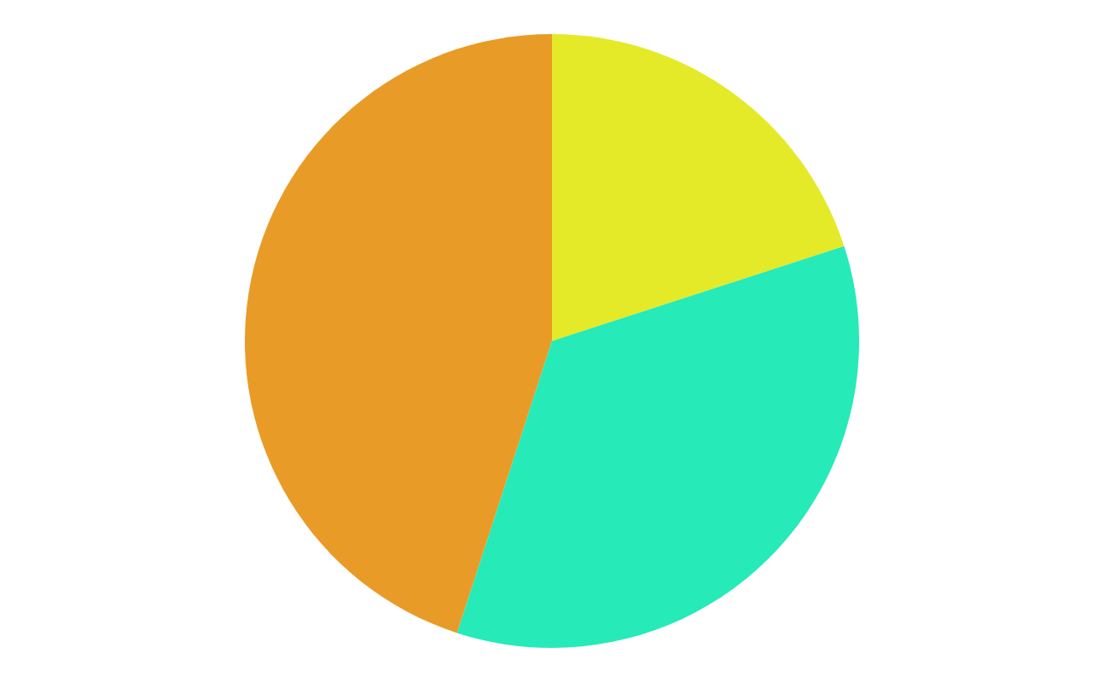
REFEERENCES
I. Wo Jae Lee, Haiyue Wu, Huitaek Yun, Hanjun Kim, Martin B.G. Jun, John W. Sutherland, “Predictive Maintenance of Machine Tool Systems Using Artificial Intelligence Techniques Applied to Machine Condition Data” in CIRP Conference on Life Cycle Engineering (LCE) Purdue University, USA, 2019.
II. Weichao Luo, Tianliang Hu, Yingxin Ye, Chengrui Zhang, Yongli Wei, “A hybrid predictive maintenance approach for CNC machine tool driven by Digital Twin“ in Shandong University, Jinan, P. R. China, 2019.
III. Alberto Jimenez-Cortadi, Itziar Irigoien, Fernando Boto, Basilio Sierra andGerman Rodriguez, “Predictive Maintenance on the Machining Process and Machine Tool” in TECNALIA, Industry and Transport Division, Leonardo da Vinci, Miñano, Spain, 2019.
IV. Bernard Schmidt, Lihui Wang, “Predictive Maintenance of Machine Tool Linear Axes: A Case from Manufacturing Industry” in 28th International Conference on Flexible Automation and Intelligent Manufacturing, Columbus, 2018.
V. Marina Paolanti; Luca Romeo; Andrea Felicetti, “Machine Learning approach for Predictive Maintenance in Industry 4.0” in 14th IEEE/ASME International Conference on Mechatronic and Embedded Systems and Applications (MESA), 2018.
VI. Thyago P. Carvalho, Fabrízzio A. A. M. N. Soares, Roberto Vita, Roberto da P. Francisco, João P. Basto, Symone G. S. Alcalá, “A systematic literature review of machine learning methods applied to predictive maintenance” in a Institute of Informatics, Federal University of Goiás, Goiânia, Goiás, Brazil, 2017.

Slide 12

THANK
YOU
MADE BY:
SARTHAK DWIVEDI [RA2111026010122]
SHASHWAT PRASAD [RA2111026010143]
YASHOWARDHAN SAMDHANI [RA2111026010151]

